Slide 1

PROBABILITY THEORY
Understanding Markov Models
A powerful mathematical framework for modeling systems that evolve over time, where the future depends only on the present moment.
Notes:
1

Slide 2
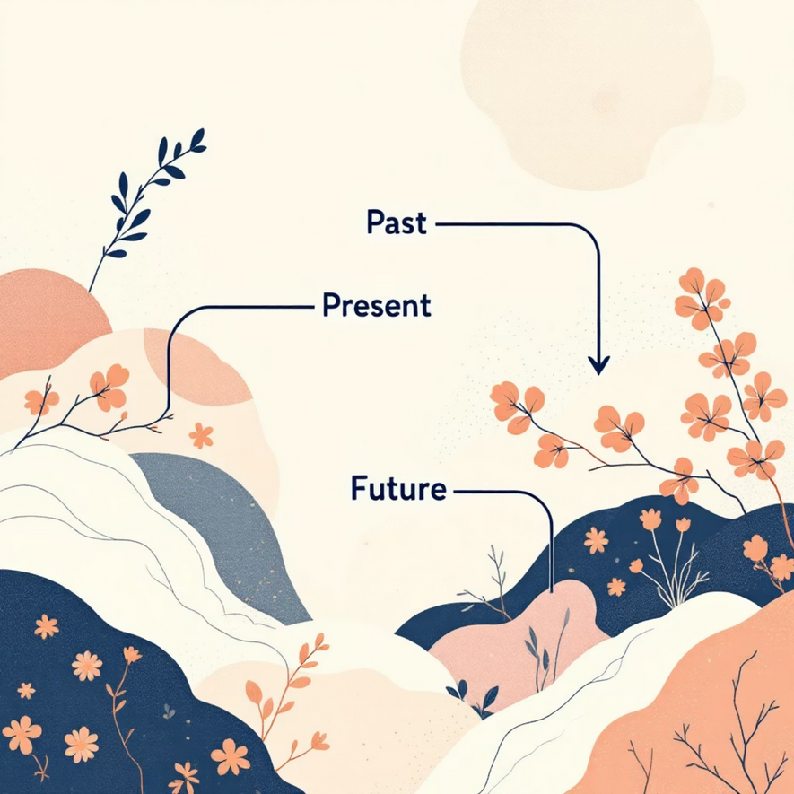
What is a Markov Model?
A Markov Model is a mathematical tool that represents systems transitioning between different states over time. These models are fundamental in probability theory and have applications across numerous fields.
The Core Principle
The defining characteristic is the Markov Property: the probability of moving to any future state depends only on the current state, not on how the system arrived there.
Notes:
2

Slide 3




The Markov Property Explained
Past States
Current State
Future State
Sₙ₋₂, Sₙ₋₁
Sₙ
Sₙ₊₁
History doesn't influence the next transition
This is all that matters for predicting what comes next
Determined solely by the present
Student-Friendly Analogy: "Tomorrow's weather depends on today's conditions, not on whether it rained two weeks ago."
Notes:
3

Slide 4


Core Components of Markov Models
States
All possible conditions the system can occupy. At any given time, the system exists in exactly one state.
Example: Sunny, Rainy, Cloudy
Transition Probabilities
The likelihood of moving from one state to another. These values are organized in a transition matrix.
Sum from any state = 1.0
Notes:
4

Slide 5
Weather Prediction Example
Let's model a simple weather system with two states to see how Markov Models work in practice.
Today's Weather → Tomorrow's Weather
Interpretation
If today is Sunny: 70% chance tomorrow is sunny, 30% chance of rain
From
Sunny
Rainy
Sunny
0.7
0.3
If today is Rainy: 40% chance tomorrow is sunny, 60% chance of more rain
Rainy
0.4
0.6
Key insight: We ignore whether it's been sunny for 10 days straight. Only today matters.
Notes:
5

Slide 6
Why Ignore the Past?
Computational Efficiency
Mathematical Simplicity
Practical Effectiveness
Storing and processing complete history is expensive. The Markov Property dramatically reduces memory requirements and speeds up calculations.
Complex systems become tractable when we only need to track the current state. This simplification enables elegant solutions to otherwise intractable problems.
For many real-world systems, the present state genuinely captures all relevant information from the past that's needed for future predictions.
Notes:
6

Slide 7






Real-World Applications
Weather Forecasting
Financial Modeling
Predicting atmospheric conditions based on current weather patterns and historical transition probabilities.
Analyzing stock market trends, credit ratings, and economic state transitions over time.
Google PageRank
Game Theory
Ranking web pages by modeling user navigation as random walks through the internet graph structure.
Modeling board games like Snakes & Ladders where position depends only on current location and dice rolls.
Traffic Engineering
Genetics
Analyzing vehicle flow patterns and optimizing traffic light timing at intersections.
Studying DNA sequences and modeling gene expression patterns in biological systems.
Notes:
7

Slide 8
Key Limitation: Observable States Required
What Markov Models Need
Where Standard Markov Models Fail
✓ Fully observable states – we must clearly know the current state of the system at all times
✗ Hidden emotional states – internal feelings not directly measurable
✓ Direct measurement – states can be determined through observation
✗ Speech phonemes – underlying sounds hidden beneath audio signal
Example: Weather conditions are directly observable
✗ Latent variables – unobserved factors driving behavior
Solution: For systems with hidden states, we use Hidden Markov Models (HMMs), an extension that can infer unobservable states from observed outputs.
Notes:
8

Slide 9
Markov Models vs. Hidden Markov Models
Standard Markov Model
States are directly observable
Simpler to implement and understand
Fewer parameters to estimate
Best for transparent systems
Hidden Markov Model (HMM)
States are hidden/latent
Observations depend on hidden states
Requires inference algorithms
Necessary for complex real systems
Notes:
9

Slide 10
Key Takeaways
01
02
Memoryless Property
Two Essential Components
Markov Models assume the future depends only on the present state, not on the sequence of past events
States (possible conditions) and transition probabilities (likelihood of moving between states)
03
04
Wide Applicability
Observable State Requirement
Used across disciplines from weather forecasting to web search algorithms to financial modeling
Standard Markov Models need fully visible states; Hidden Markov Models extend this to latent variables
Next Steps: Practice building transition matrices, explore Hidden Markov Models, and study convergence to steady-state distributions.
Notes:
10

